Slide 1
Unit-2 (Part-2)
Logic Concepts

Slide 2
Logic concepts and logic programming
Logic can be defined as the proof or validation behind any reason provided.
It is important to include logic in Artificial Intelligence because we want our agent (system) to think and act humanly, and for doing so, it should be capable of taking any decision based on the current situation
Logic is concerned with the principles of drawing valid inferences from a given set of true statements.
Logical languages are widely used for expressing the declarative knowledge needed in artificial intelligence systems.

Slide 3
Logic concepts and logic programming
Symbolic logic is the study of symbolic abstractions.
Symbolic logic also provides a clear semantics for knowledge representation languages.
Symbolic logic is divided into two branches:
Prepositional logic
Predicate Logic

Slide 4
Logic concepts and logic programming
A preposition refers to a declarations struct that is either true or false (but not both) in a given context.
Using logic, we can generate/infer new propositions from a given set of propositions in same context.
Logic is also concerned with:
validity
consistency &
inconsistency
Logical systems should possess properties such as consistency, soundness & completeness:
Consistency – None of the theorems of the systems should not contradict each other.
Soundness – false inference should not be informed from true premises.
Completeness – there are no true sentences in the sequences that cannot be proved.

Slide 5
Propositional Calculus (PC):
Refers to language of propositions in which set of rules are used to combine simple propositions to form compound propositions using logical operators.
These logical operators are also called as connectives:
Example:
not(~)
and(^)
or(ѵ)
implies(↔)
equivalence(↔)

Slide 6
Propositional Calculus (PC):
A well-formed formula is defined as a symbol or a string of symbols generated by the formal grammar of a formal language.
Some of the properties of Well-Formed Formula (WFF) in PC are:
The smallest unit (or an atom) is considered to be a WFF.
If α is a WFF, then –α is also a WFF.
If α & β are WFF, then (α^β),(αѵβ),(α →β),&(α↔β)are also WFF.
A propositional expression is called a WFF if and only if it satisfies the above properties.

Slide 7
Truth Table
Truth table provides operational definitions of important logical operators.
Truth table elaborates all possible truth values of a formula.
The logical constants in PC are true & false, represented as T &F.
Table. Truth table for logical operators
A | B | ~A | A^B | AѵB | A→B | A↔B
T | T | F | T | T | T | T
T | F | F | F | T | F | F
F | T | T | F | T | T | F
F | F | T | F | F | T | T

Slide 8
Example:
Compute the truth value of α : (AѵB)^ (~B→A) using truth table approach.
Table. Truth table for α
A | B | AѵB | ~B | ~B→A | α: (AѵB)^(~B→A)
T | T | T | F | T | T
T | F | T | T | T | T
F | T | T | F | T | T
F | F | F | T | F | F

Slide 9
Definition: Two formulae α & β are said to be a logically equivalent (α β) if and only if the truth values of both are same for all possible assignments of logical constants (T or F) to the symbols appearing in the formula.
Equivalence laws :
Equivalence relations (or laws) are used to reduce or simplify a given well-formed formula
(or)
to derive a new formula from the existing formula.

Slide 10
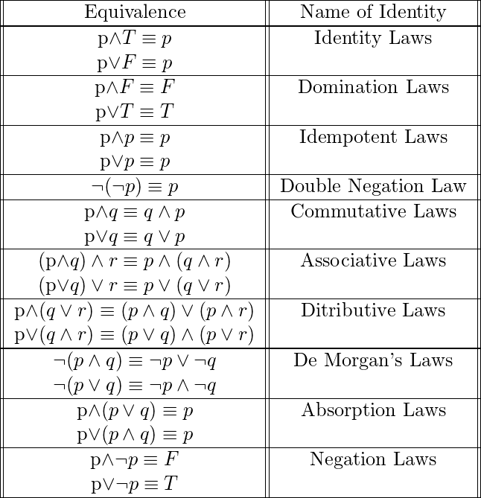
Table. Equivalence laws (Refer Text book)

Slide 11
Equivalence laws can be verified by using the truth table approach.
Ex ample:
Aѵ(A^B) A
Table. Verification of Aѵ(A^B) A
A | B | A^B | Aѵ(A^B)
T | T | T | T
T | F | F | T
F | T | F | F
F | F | F | F

Slide 12
Propositional logic (prop logic)
It deals with validity, satisfiability (consistency) & unsatisfiability (inconsistency) of a formula &derivation of new formula using equivalence laws.
Each row of a truth table for a formula is called its interpretation under value of a formula is either true or false.
A formula is said to be tautology if its true for all its interpretations.
A formula α is said to be valid if & only if it is a tautology.
A formula α is said to be satisfiability if there exists atleast one interpretation for which value of α is true.
A formula α is said to be unsatisfiable if the value of α is false under all interpretations.

Slide 13
Propositional logic (prop logic)
There are three types of propositions when classified according to their truth values:
Tautology – A proposition which is always true, is called a tautology.
Contradiction – A proposition which is always false, is called a contradiction.
Contingency – A proposition that is neither a tautology nor a contradiction is called a contingency.

Slide 14
Propositional logic (prop logic)
Example: Show that the following is a valid argument.
If it is humid then it will rain &since it is humid today it will rain.
Solution:
Let us symbolize each part of the above english sentence by propositional atoms as follows:
A : It is humid
B : It will rain
Now, the formula corresponding to the given above sentence can be written as:
α: [(A→B)^A]→B

Slide 15
Propositional logic (prop logic)
Table. Truth table for [(A→B)^A]→B
A | B | A→B | (A→B)^A | [(A→B)^A]→B
T | T | T | T | T
T | F | F | F | T
F | T | T | F | T
F | F | T | F | T
As α is true for all interpretations hence is a valid argument.

Slide 16
Disadvantages of truth table method:
Propositional logic (prop logic)
Size of truth table grows exponentially.
If a formula contains n atoms, then truth table contains 2ᵑ entries.
Wastage of time to construct large tables with many useless interpretations.
Some other methods to prove the validity of the formula are:
Natural deduction system
Axiomatic system
Semantic tableau method
Resolution regulation method

Slide 17
Natural Deduction System
It mimics the pattern of natural reasoning.
It is based on a set of deductive inference rules.
Let A1,A2,…..Ak, where 1≤k≤n are set of atoms and αj, 1≤j≤m and β are well-formed formulas.

Slide 18
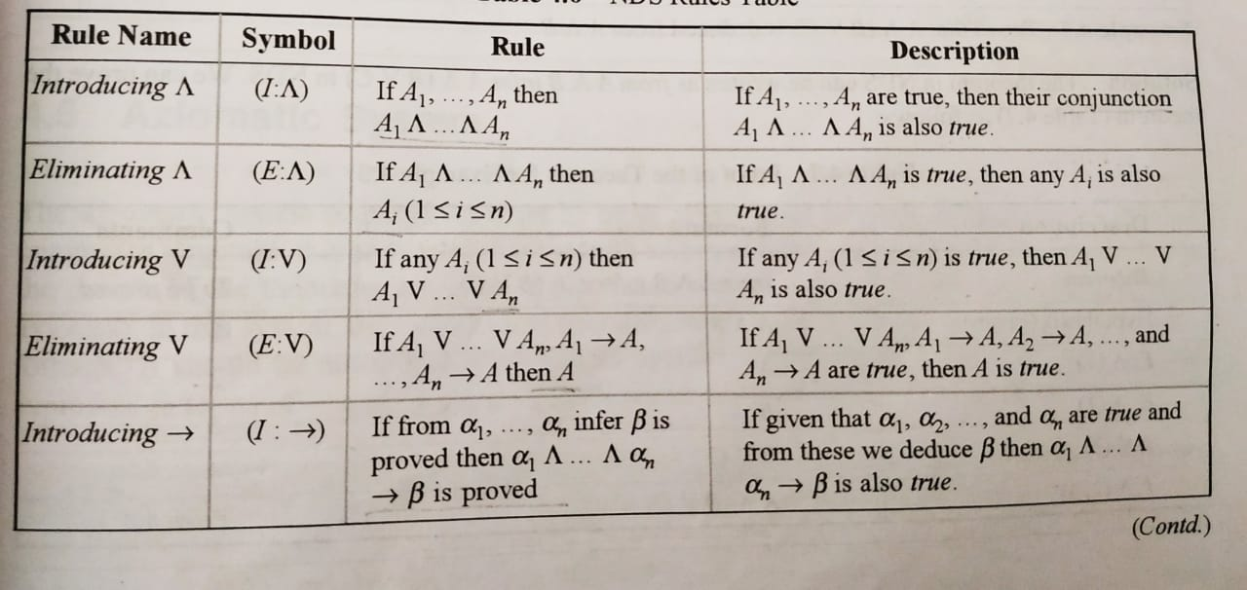
The inference rules may be stated as given in the NDS rules Table below:

Slide 19
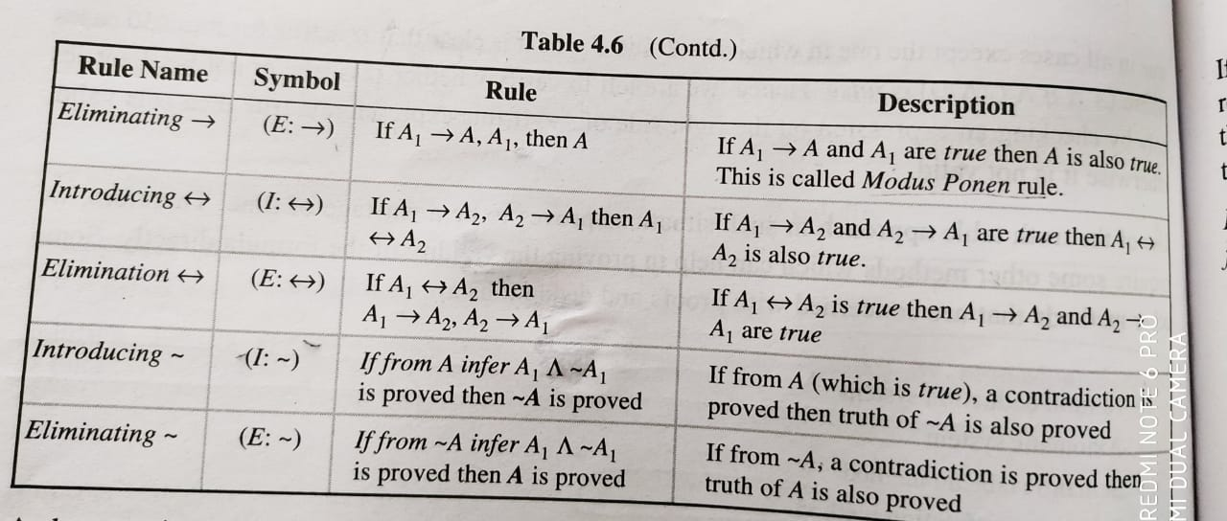

Slide 20
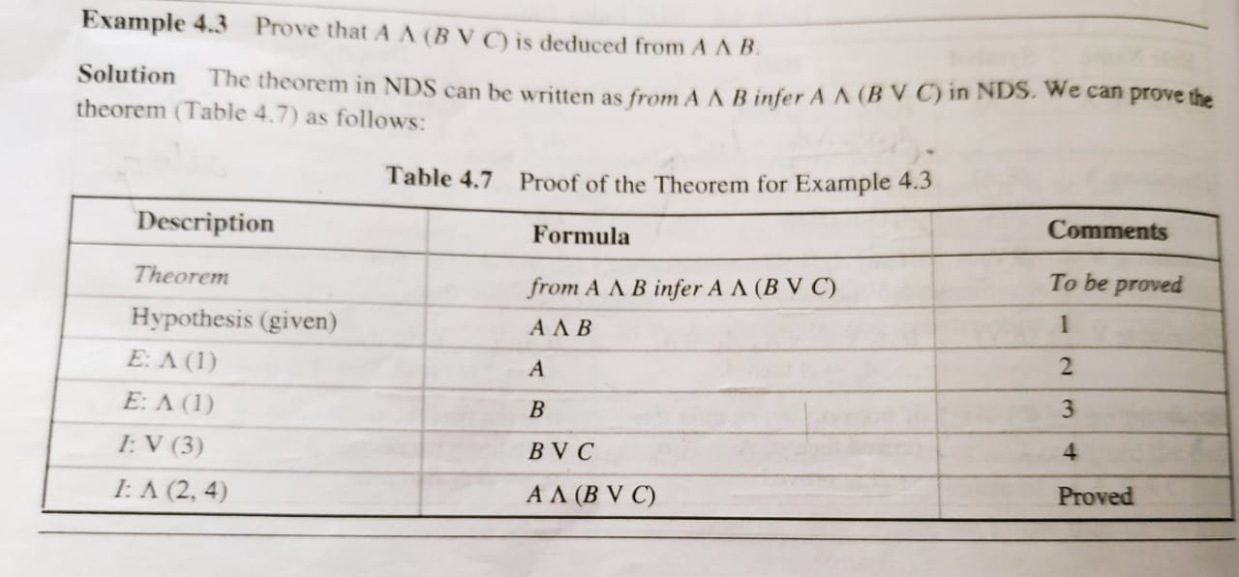
Natural Deduction system Example 1:
Description –rule to be applied on a sub expressions.
Formula- Output of applying a rule.
Comments- Line nos.

Slide 21

Deduction Theorem:

Slide 22
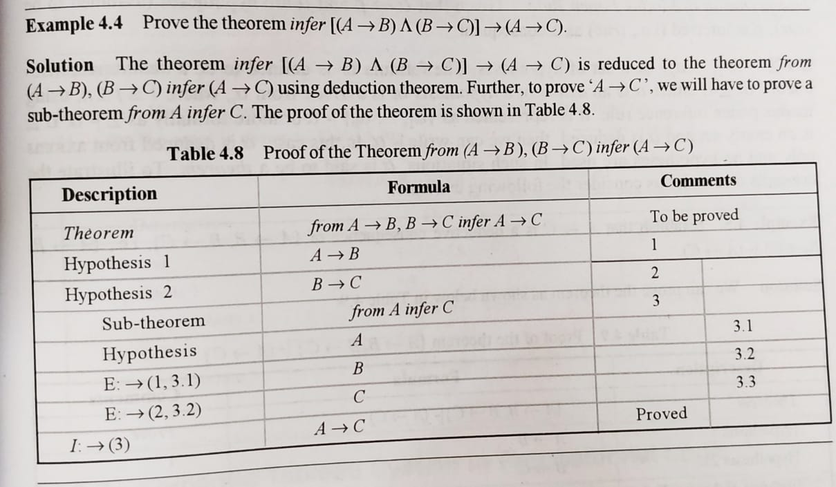
Natural Deduction system Example 2:

Slide 23
3.Prove that A→ B^C,A infer C
Sol:
Description | Formula | Comments
Theorem | From A→ B^C, A infer C | To be proved
Hypothesis 1 | A→B^C | 1
Hypothesis 2 | A | 2
E:→(1,2) | B^C | 3
E:^(3) | B | 4
E:^(3) | C | Proved

Slide 24
4.PT Q→P,Q→R infer Q→(P^R)
Sol:
Description | Formula | Comments
Theorem | Q→P,Q→R infer Q→(P^R) | To be proved
Hypothesis 1 | Q→P | 1
Hypothesis 2 | Q→R | 2
Subtheorem | From Q infer (P^R) | 3
Hypothesis | Q | 3.1
E:→(1,3.1) | P | 3.2
E:→(2,3,1) | R | 3.3
I:^(3.2,3.3) | P^R | Proved

Slide 25
5.Infer A^B↔B^A
Sol: infer A^B↔B^A is reduced to the theorem from A,B infer
Description | Formula | Comments
Theorem | A^B↔B^A | To be proved as T
Hypothesis | A^B↔B^A | 1
E:↔(1) | A^B→B^A | 2
E:↔(1) | B^A→A^B | 3

